Slide 1





26-1-D-10
Assigned by:
Adam Kayal 211584271
Maor Tzur 316313543
supervisor: Ilya Zelder

Slide 2

01
Introduction & Problem Definition
02
Analysis & Specifications
Agenda
03
Engineering Development & Challenges
04
The Solution: Architecture & Logic
05
Testing, Results & Future Outlook
-3-

Slide 3
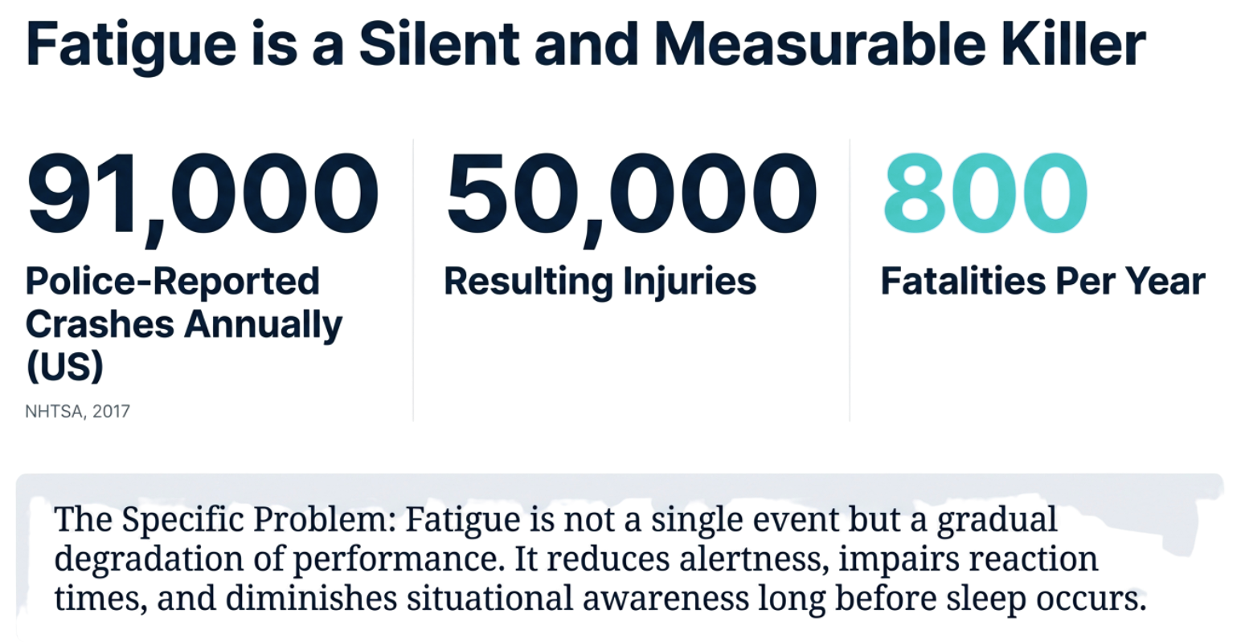
-3-

Slide 4
current limitations
Problem | Industry Standard | Our Solution
False Positives | 13%> | 5% (hysteresis + temporal context)
Latency | 412ms avg (cloud) | <50ms (100% edge)
Explainability | Black-box CNN | Medical rule traceability
Operation | Often reactive; triggers after performance degrades. | Proactive; reasons about the evolution of driver state.
-4-

Slide 5
OUR SOLUTION
Context-Aware AI Agent for Driver Safety
LLM-based reasoning instead of rigid if-else rules
100% edge-based: No cloud, no privacy concerns
Real-time fatigue detection using computer vision
-5-

Slide 6

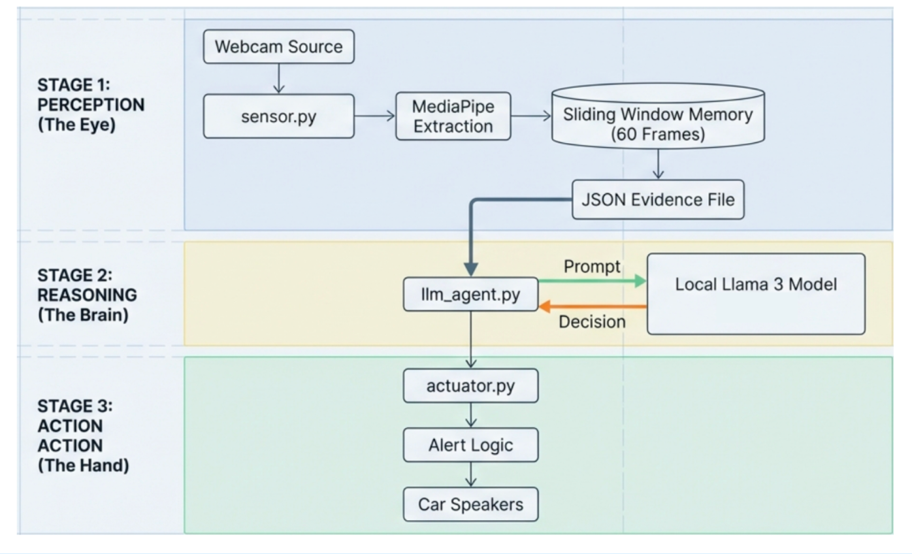
AureDrive Architecture
-6-

Slide 7
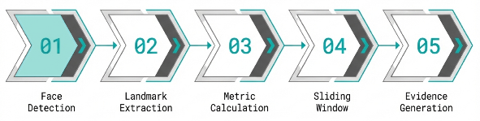
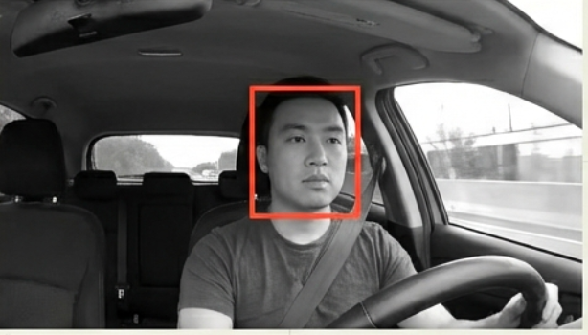
FaceDetection & Alignment
Lightweight CNN-based single-shot detector (~200KB model) optimized for front-facing cameras
Scans full frame to locate face and extract tight bounding box (5-7ms per detection)
Runs once initially, then only when tracking confidence drops or face is lost
-7-

Slide 8
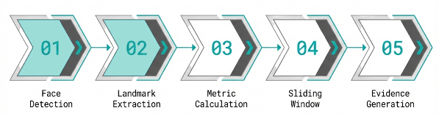
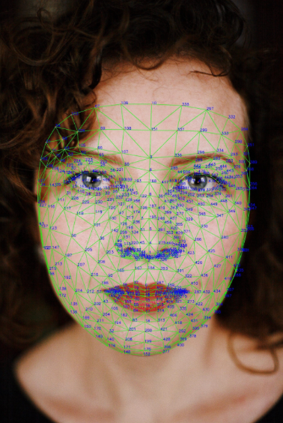
Landmark Tracking
Extracts 468 3D facial landmarks from cropped face region (2-3ms per frame)
Uses temporal continuity - predicts face position based on previous frame motion
Avoids expensive full-frame detection by tracking within predicted region
-8-

Slide 9
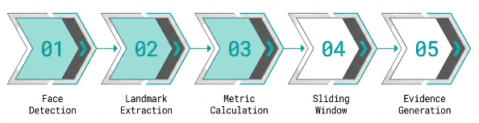
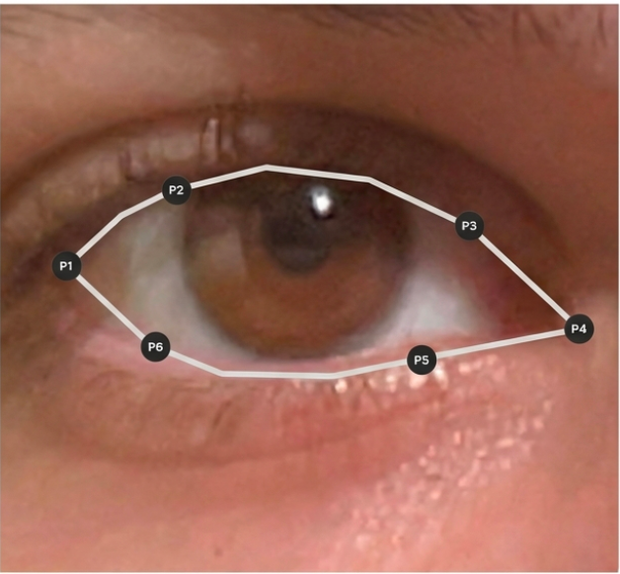
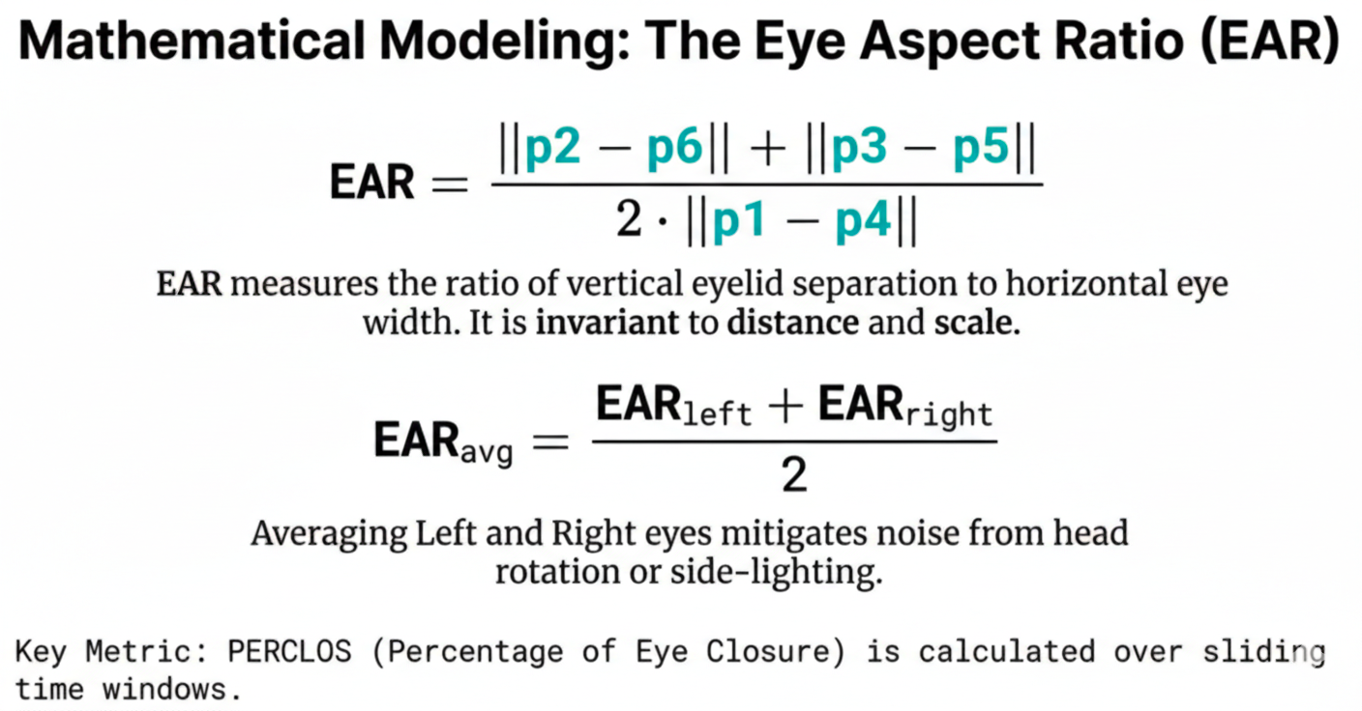
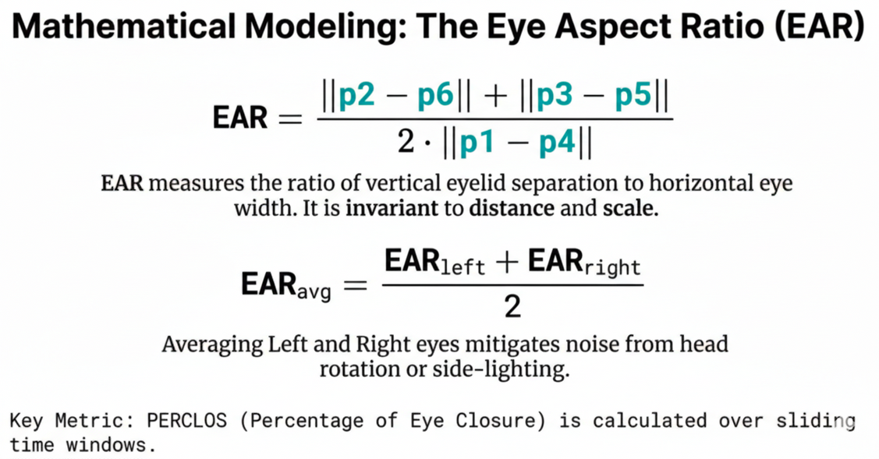
Mathematical Modeling
The Eye Aspect Ratio (EAR)
-9-

Slide 10
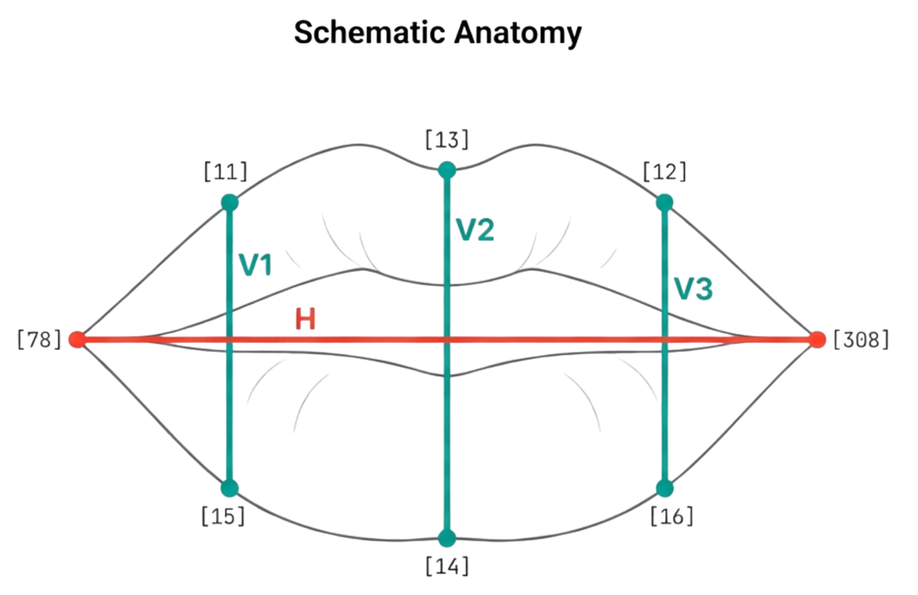
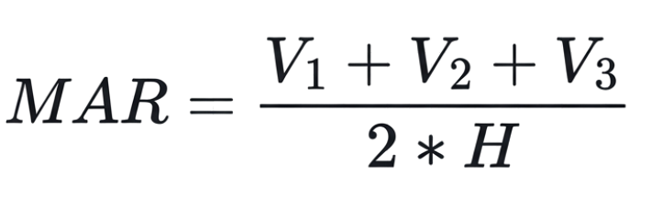
Mathematical Modeling
-10-

Slide 11
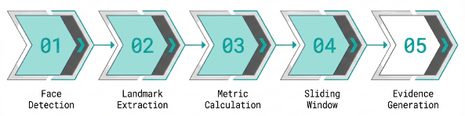
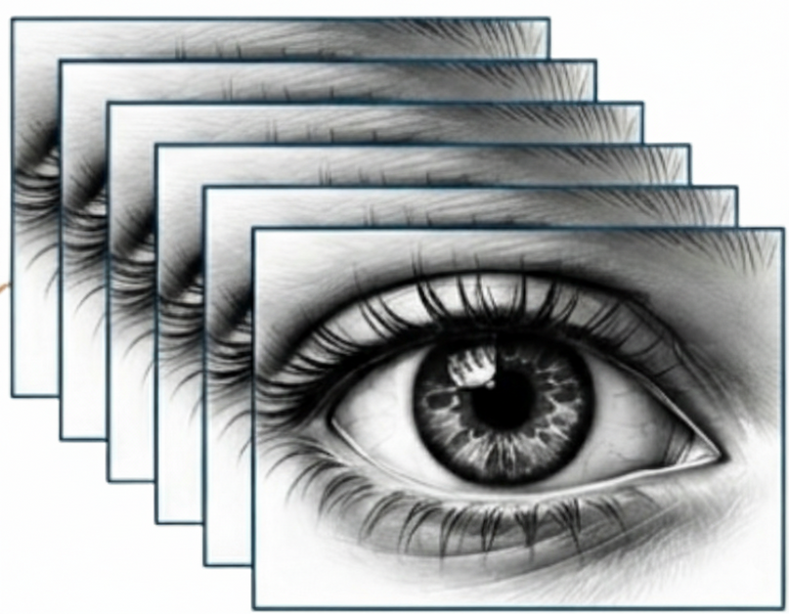
Sliding Window
Is this a blink? A mirror check? Micro-sleep?
The Challenge: Detecting State, Not Just Symptoms
Fatigue is a process, not a single frame.
Context reveals intent.
-11-

Slide 12
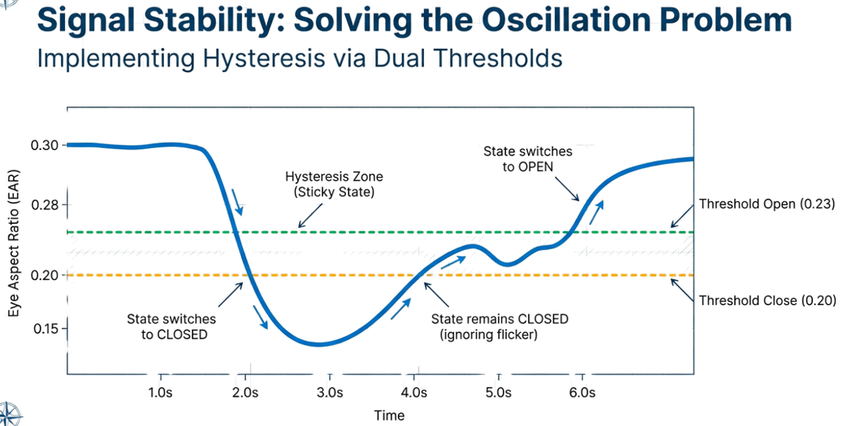
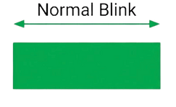
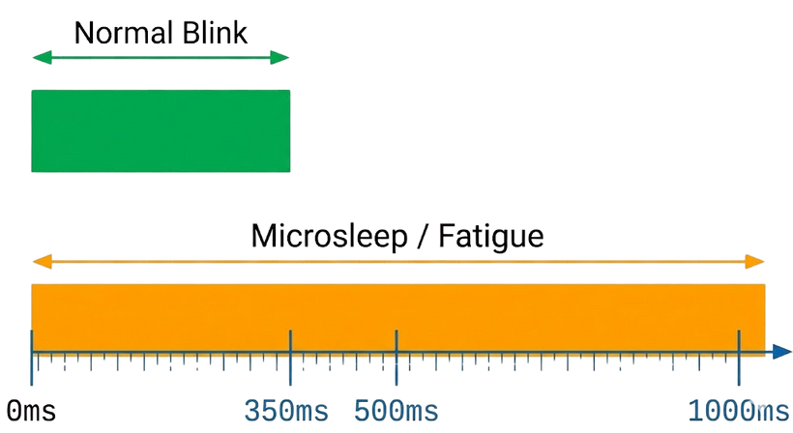
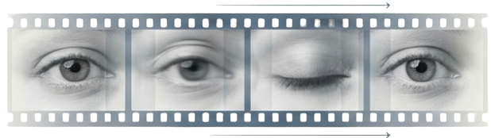
Three Time Windows Working Together:
Fast Window: Blink Detection
Medium Window: Microsleep Detection
Long Window: PERCLOS Monitoring
-12-

Slide 13
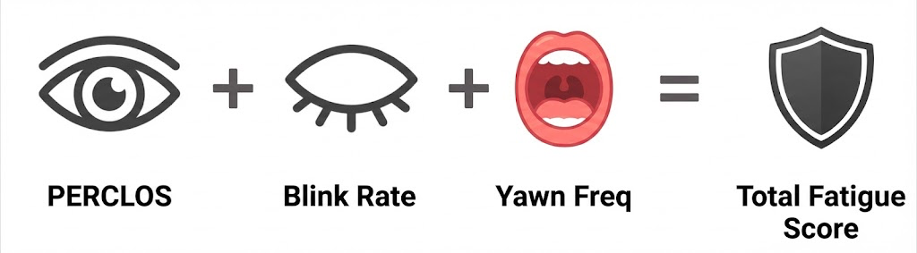
Multi-Modal Fatigue Scoring
-13-

Slide 14
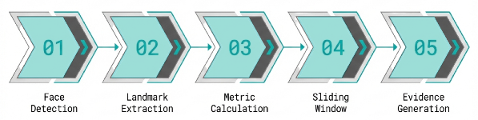
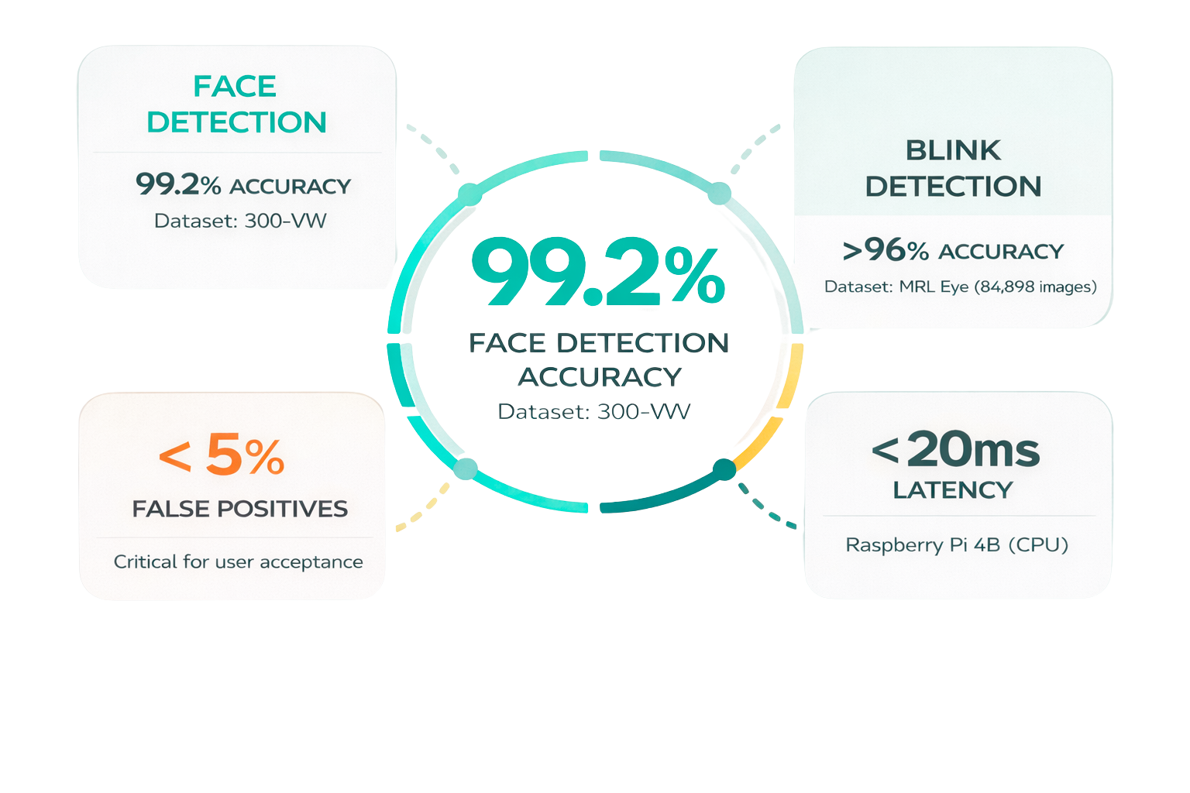
Visual Perception Accuracy
-14-

Slide 15
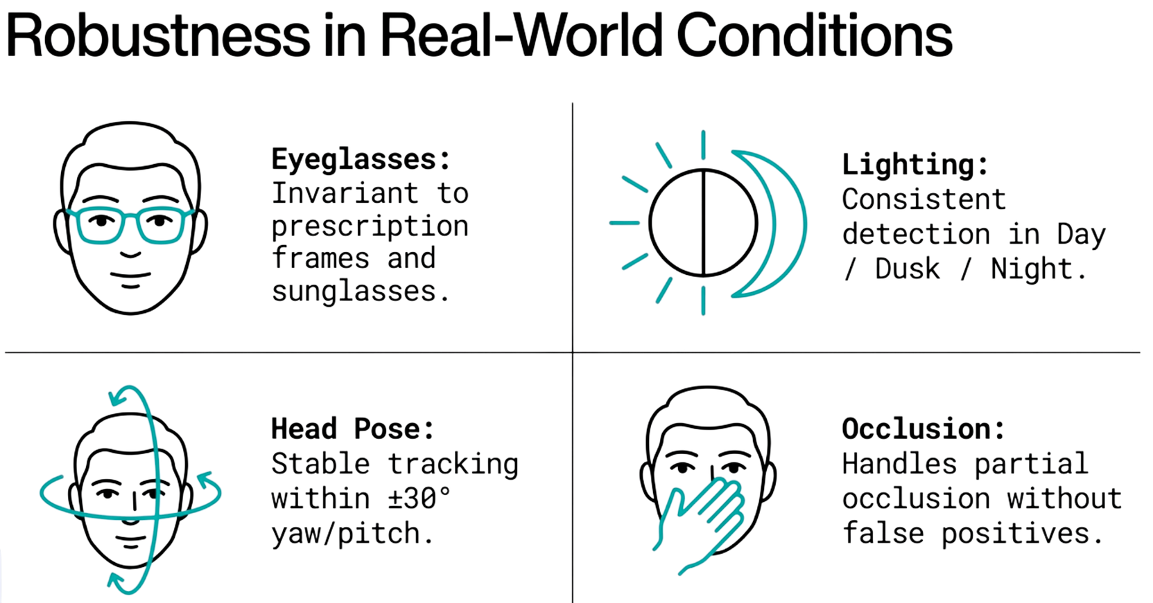
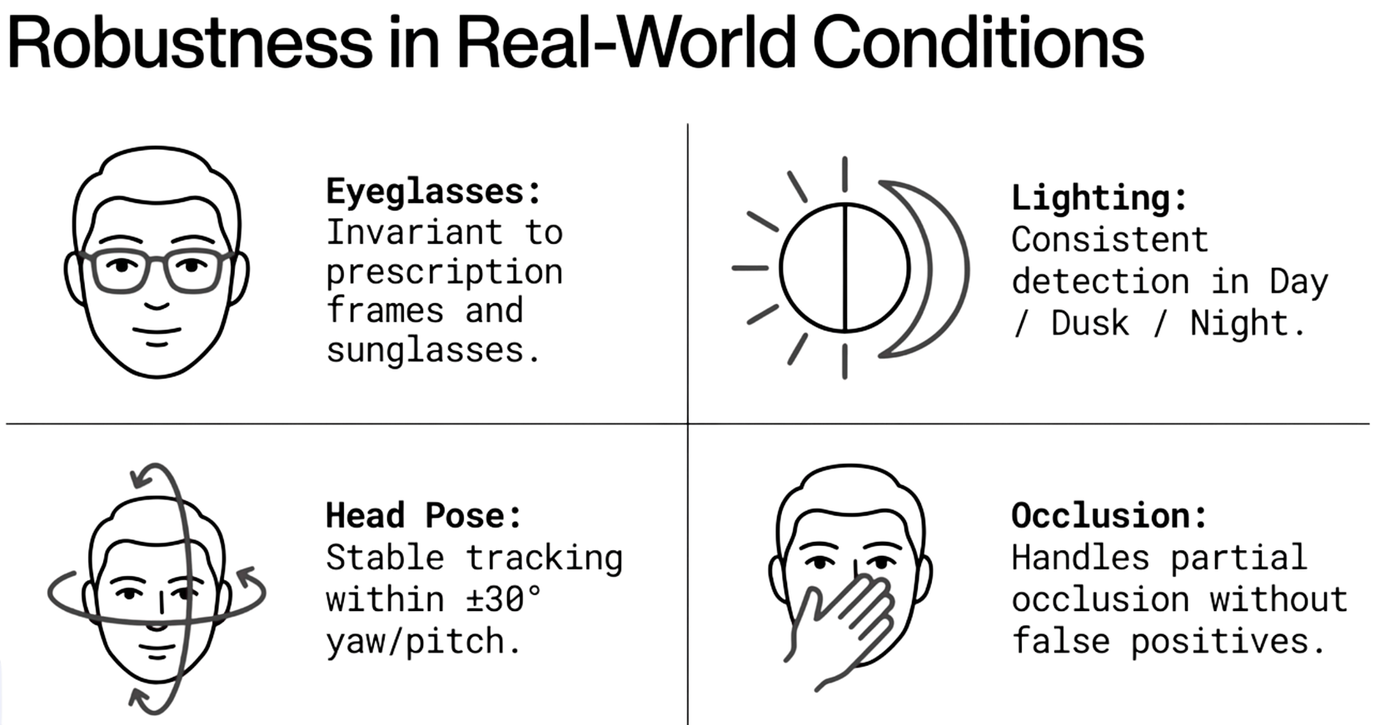
robustness in real word- Testing
-15-

Slide 16

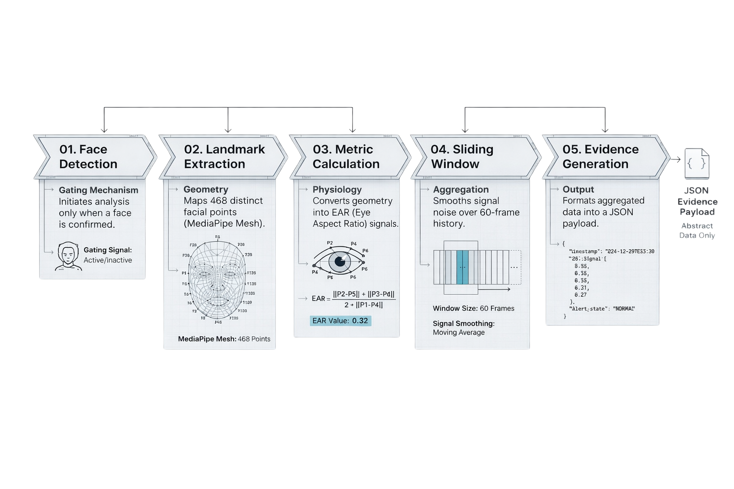
SUMMARIZE OF STAGE 1
-16-

Slide 17
STAGE 2 - adding intelligence and reasoning
Fatigue is a progressive physiological decline rather than a binary state.
Why LLM Agent?
Beyond If-Else Logic Traditional Systems:
- Evaluate isolated thresholds
- No temporal context
- High false positive rates
Our LLM Agent:
- Reasons over patterns across time
- Maintains behavioral consistency
- Context-aware decisions
-17-

Slide 18
Reasoning Stage Technology Stack
:Local LLM Inference
Model: Llama 3.2 (Meta) -
Runtime: llama.cpp (local execution) -
?Why local
Zero network latency -
Privacy preservation -
Works offline -
-18-

Slide 19
LLM Chain Stages using LLAMA
Structured Input – The system sends summarized driver metrics (EAR, PERCLOS, blink rate, eye state) as JSON
Context Building – Data is treated as a continuous driver state, not a single frame event
Reasoning – The model evaluates risk level (no action / gentle / urgent alert)
Decision Output – A clear, structured command is returned for the alert system
-19-

Slide 20
Research Phase: Working with LLAMA & Identified Challenges
Understanding Model Behavior – Learning how the LLM reacts to numerical, structured data
Determinism Control – Preventing creativity and enforcing consistent, predictable decisions
Latency Evaluation – Verifying the model meets real-time requirements
Prompt Design – Iterating prompts to avoid ambiguous or unclear decisions
-20-

Slide 21
Why llama.cpp (Python) on NVIDIA Jetson
Fully Local Execution – No cloud dependency, all inference runs on-device
Hardware Compatibility – Jetson is powerful enough to run LLAMA 3 in real time
Efficiency & Performance – llama.cpp is lightweight and optimized for low latency
Comparison to Alternatives – Preferred over cloud APIs or heavy frameworks for privacy and timing
-21-

Slide 22
How the LLM Agent Evaluates Fatigue?
The answer is Priority-Based Rule Hierarchy!
R1 (Highest Priority): Eyes closed >2000ms → EMERGENCY
R2: Eyes closed >500ms → URGENT
R3: PERCLOS >0.30 AND EAR <0.20 → URGENT
R4: PERCLOS >0.30 OR prolonged closure → MODERATE
R5-R7: Early warning and normal states
-22-

Slide 23
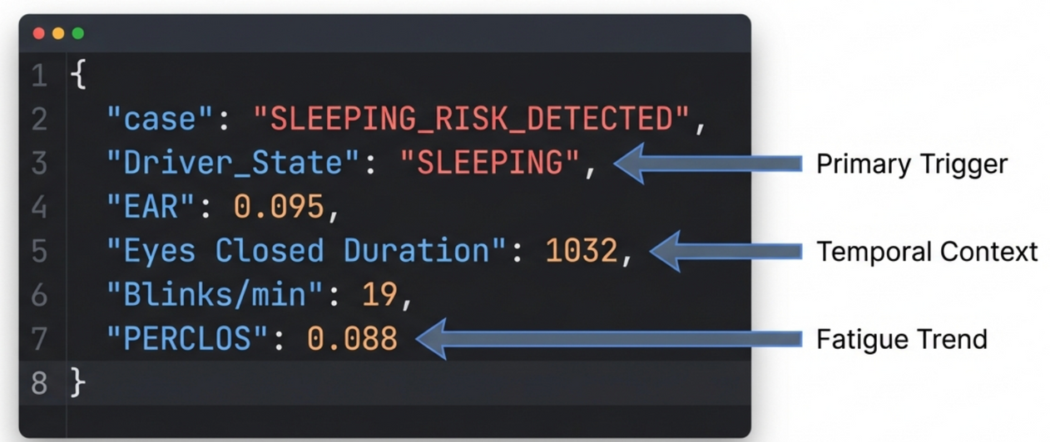
Agent Input/Output
Structured JSON Communication
:Input Example from Stage 1
:Output to Stage 3
{"command": "URGENT_ALERT","sleep": 0, "severity": "HIGH"}
-23-

Slide 24
Agent Constraints - Ensuring Deterministic Behavior
Forbidden: Free-form text, multiple commands, non-determinism
Enforced: Strict JSON schema validation
Fallback: Protocol-level error handling for invalid LLM outputs
Result: Predictable, auditable decisions

Slide 25
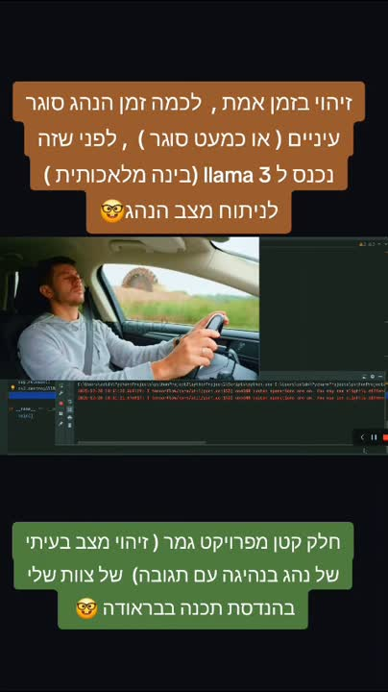
demo

Slide 26
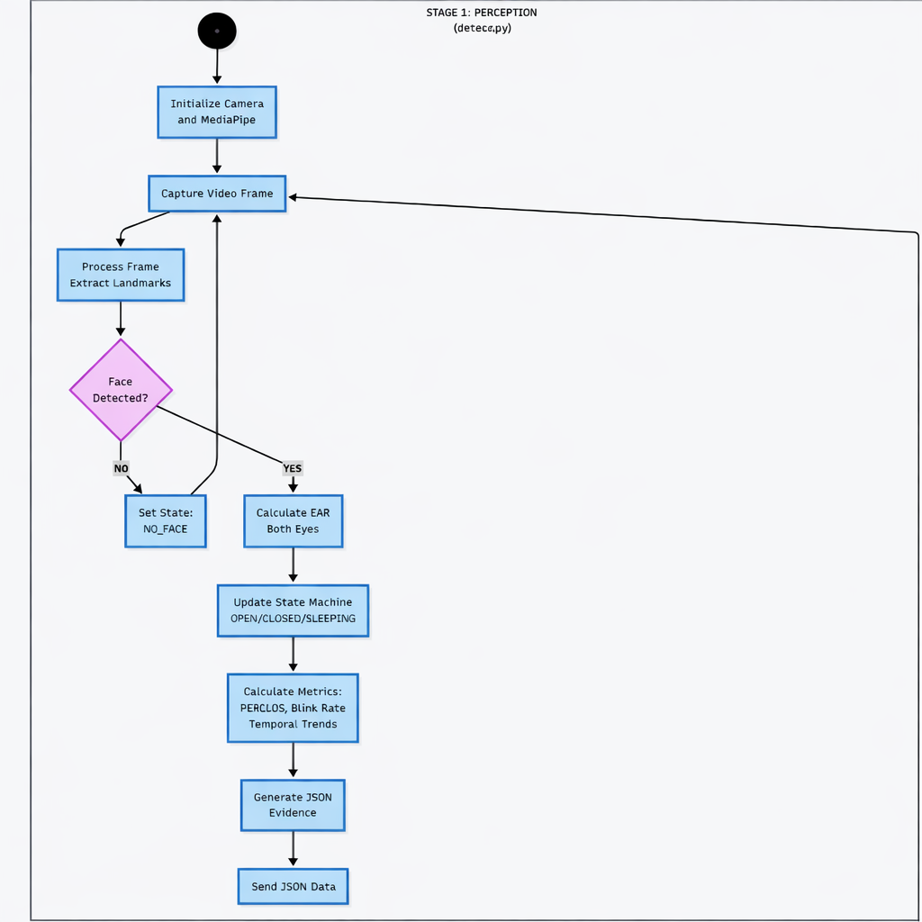
activity diagram
part 1

Slide 27
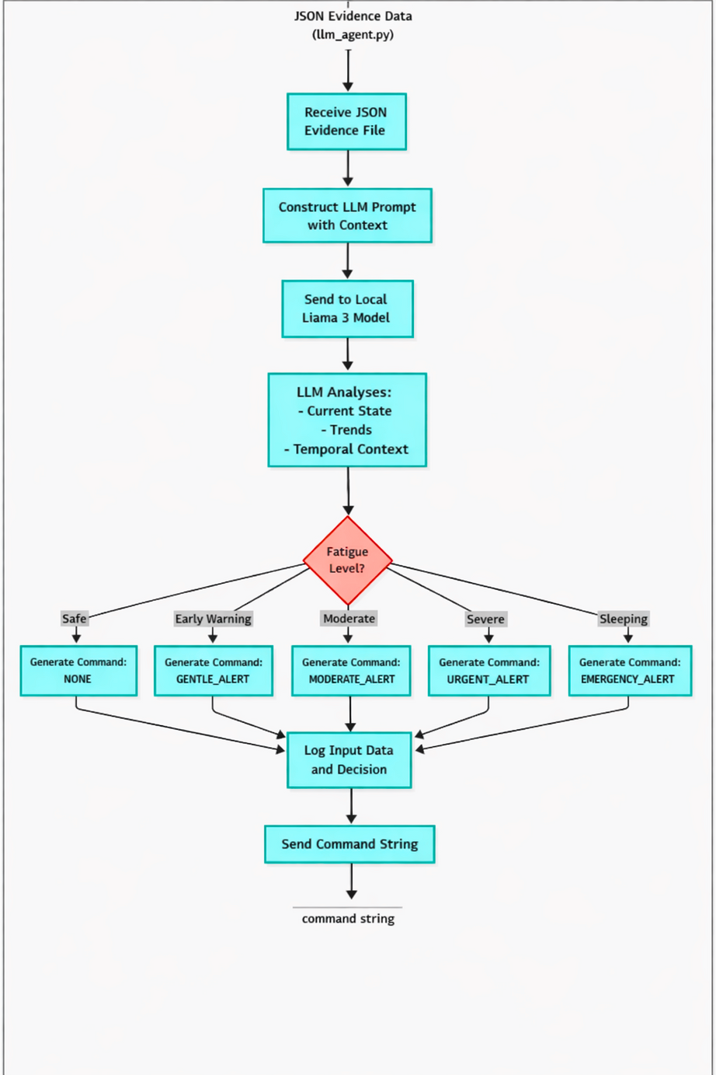
activity diagram
part 2

Slide 28
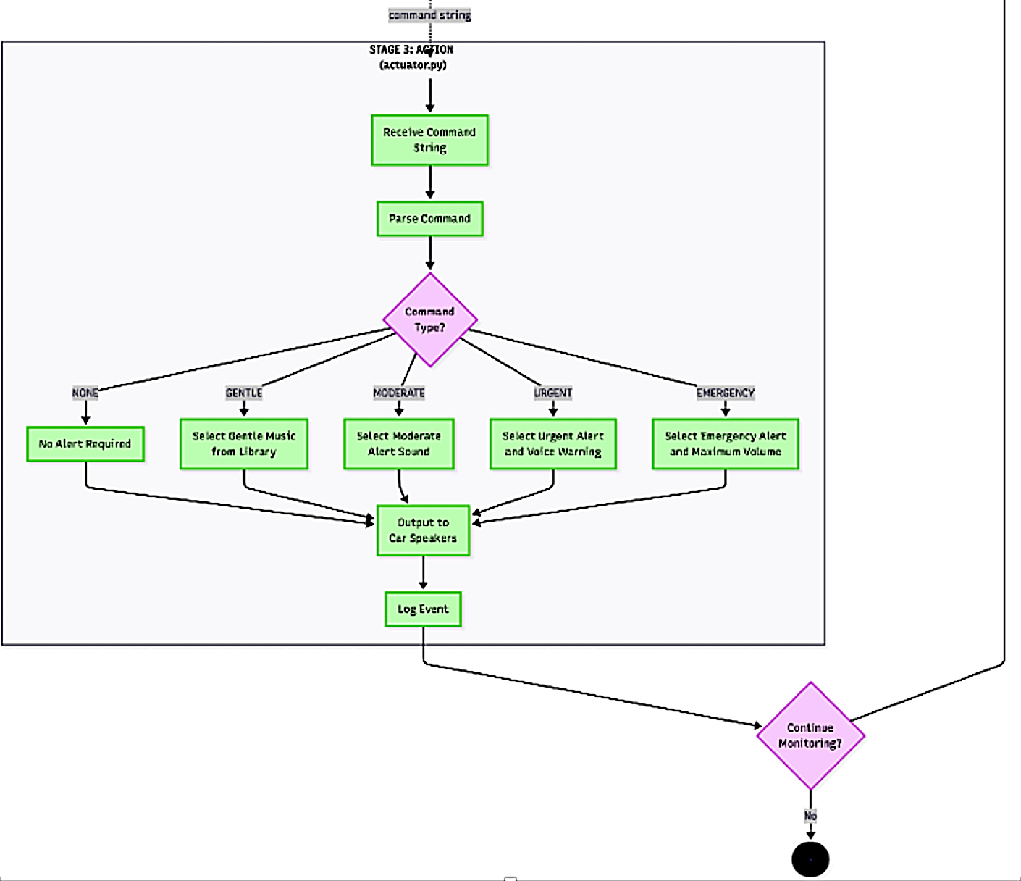
activity diagram part 3

Slide 29
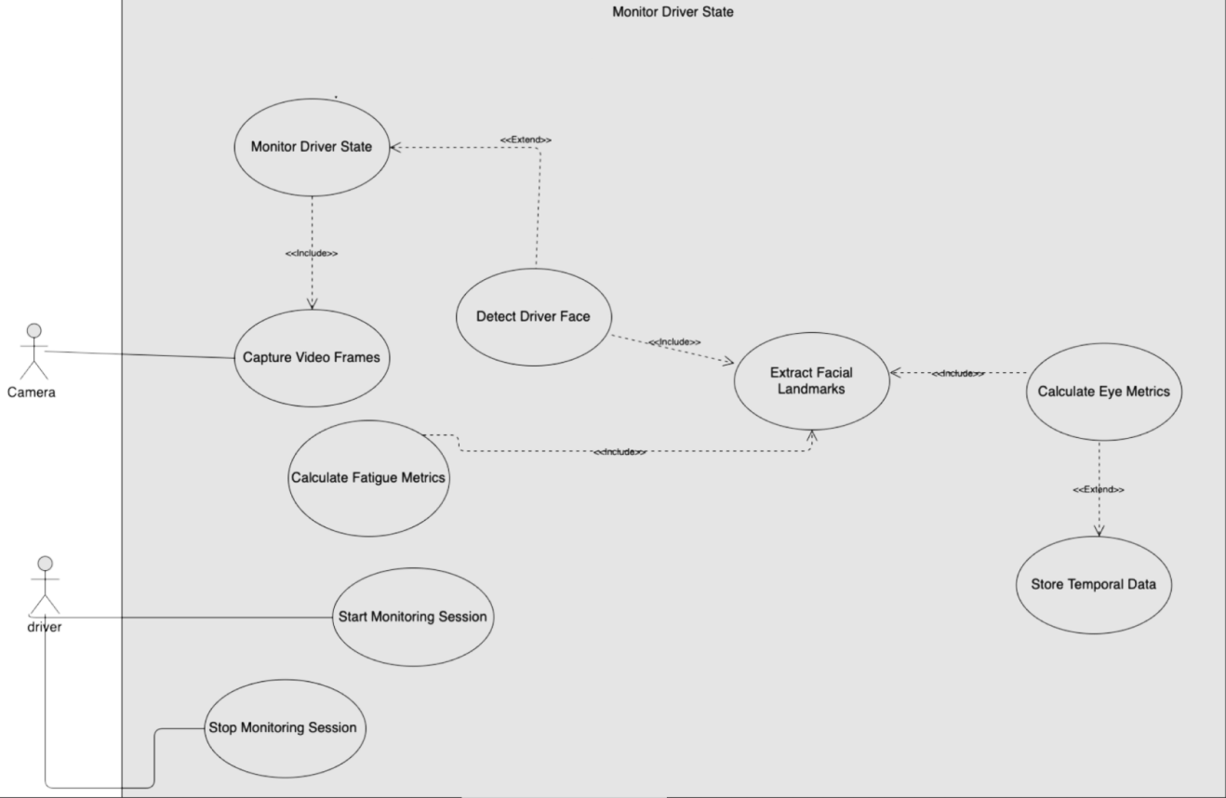
use case Diagram

Slide 30
Alert Generation - Tiered Response System
GENTLE_ALERT: Early warning audio cue
MODERATE_ALERT: Persistent tone + visual indication
URGENT_ALERT: Loud alarm + immediate intervention prompt
EMERGENCY_ALERT: Maximum intensity + safety recommendation

Slide 31
Key Achievements - What We will Accomplish
Pure LLM autonomy: No external validation logic
Real-time stream processing: NDJSON pipeline with freeze prevention
Medical-grade thresholds: Based on NHTSA/ISO standards
Edge deployment ready: llama.cpp + Llama 3.2 local inference

Slide 32




Next Steps - Semester B Roadmap
Real-world vehicle testing
Integrate emotion detection for stress/aggression
Add contactless heart rate detection
Migrate from PC to embedded hardware

Slide 33
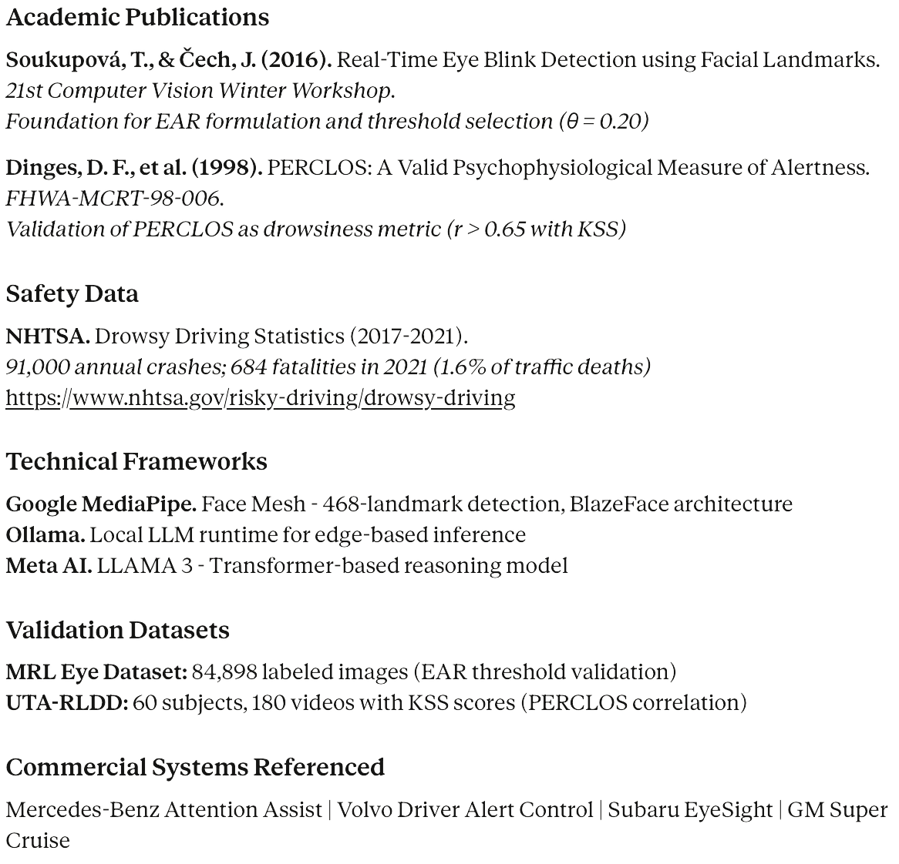
References

Slide 34
Thank You
Questions?

